Slide 1

DAYANANDA SAGAR UNIVERSITY
SCHOOL OF ENGINEERING
Department of Computer Science and Technology
Major Project Stage-II
PERFORMANCE IMPROVEMENT OF ML ALGORITHMS FOR WEATHER FORECASTING
Under the Supervision
Prof. Vedashree L V
1
Presented By:
Suvik Sharma M S ENG19CS0327
Varsha R ENG19CS0354
Vignesh S ENG19CS0360
Yashodha C R ENG19CS0368
Notes:
Title of the project
CSE Dept., SET-Jain University
1

Slide 2
Overview
Abstract
Problem Statement
Introduction
Environmental Impact
State of the Art work
Design
Deliverables
References
Dept of CSE., SOE-Dayananda Sagar University
2 of 39
*

Slide 3
Abstract
Weather plays an important role in our everyday life.
The climate is changing at a drastic rate nowadays, which makes the old prediction less effective & hectic.
We plan to approach the everyday unpredictable weather, with a model that helps us to forecast the weather with available data.
A comparatively reliable application model, that forecasts better than the conventional method of the same.
Dept of CSE., SOE-Dayananda Sagar University
3 of 39
*

Slide 4
Problem Statement
A lot of the primary sector activities depend on weather forecasting for production & entertainment i.e., Farming, Mining, Construction, Logistics & Turf-related sports.
The weather is a continuous, data intensive, multi dimensional, dynamic & a chaotic process, and these properties make weather forecasting a formidable challenge.
Predicting the weather conventionally is not very accurate and efficient, hence we use
Problem: To be able to predict / forecast weather, to protect life, property & crops.
Solution: Machine learning. Why? How? When?
Dept of CSE., SOE-Dayananda Sagar University
4 of 39
*

Slide 5
Introduction
There are a lot of weather forecasting agencies in the world that can be relied up, but however accurate any model might be, we can never expect 100% accuracy of the same.
We plan to additional features to the model, or classifiers, data points available to make the prediction a little more reliable than the conventional method.
An already existing weather forecasting model will be used to apply the feature addition technique to make the model more reliable.
Dept of CSE., SOE-Dayananda Sagar University
5 of 39
*

Slide 6
Environmental Impact
Almost 10% of global deaths (approximately 5 million deaths every year) can be attributed to abnormally hot or cold temperatures.
Climate change affects the social & environmental determinants of health – clean air, safe drinking water, food & shelter.
There are a variety of end users to weather forecasting.
Weather warnings are important as they can be used to protect life & property.
Dept of CSE., SOE-Dayananda Sagar University
6 of 39
*

Slide 7
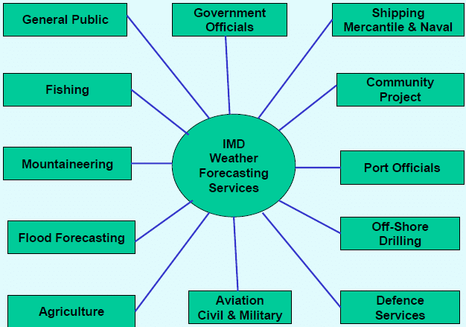
Applications of weather forecasting
Fig.1. End Users of Weather Forecasting System
Dept of CSE., SOE-Dayananda Sagar University
7 of 39
*

Slide 8
State of the Art-work
Author’s name / Paper title | Conference/Journal name & year | Technology/Design | Results shared by author | Inference
Designing a model for weather forecasting using machine learning | IEEE, International Conference on Electronics and Sustainable Communication Systems, August 2020 | Hidden Markov Model | HMM can be used for speech recognition, pattern matching, etc. | Predicts weather based on mathematical model, it is based on time-series data
Weather forecasting using machine learning techniques | KNIT, International Conference on Advanced Computing and Software Engineering, May 2019 | SVM, ANN & RNN | Comparing prediction models with a windowed duration of 8 weeks | Calculated RMS error, RNN is implied to be a better method for weather forecasting.
Smart weather forecasting using machine learning: a case study in Tennessee | Researchgate, Tennessee Tech University, August 2020 | Linear Regression model | 1st result set, shows accuracy of weather prediction in 1st city, 2nd result set shows performance improvement | Utilizing historical data to predict weather accurately
Dept of CSE., SOE-Dayananda Sagar University
8 of 39
Notes:
8

Slide 9
Author’s name / Paper title | Conference/Journal name & year | Technology/Design | Results shared by author | Inference
Weather forecasting using machine learning algorithm | IEEE, International Conference of Signal Processing & Communication, December 2019 | Random forest classification | Whether it will rain or not on a particular day, using real data from sensor. | Using DHT sensor for real time and the graph given shows dependency on temperature, humidity and pressure.
Weather forecasting using machine learning | SSRN, Galgotias University, February 2037 | Supervised learning – Random forest, Choice Tree, Regression & Boosting | Relationship between Temperature altitude / latitude relationship | For 1 wrong prediction, the square may skew the entire data model. More problematic when there is noisy data.
Weather Forecasting Using Artificial Neural Network | IEEE, International conference 2018 | Parameters such as temperature, precipitation, wind speed and so on are used to train an LSTM model and then predict the weather from the obtained data. | LSTM model provides better & accurate results for weather forecasting. | The proposed method i.e., LSTM model produces better weather weather forecasting than Back tracking, Feed forward neural network, Clustering and back propagation, Radial basis function network, & ANN using fireworks algorithm
Weather forecasting model using Artificial Neural Network | Elsevier , Journal , 2012 | Feed forward network used by the model | Feed forward network used by the model | Increasing the number of neurons to the system, increases the performance. Increasing number of samples, increases performance.
Dept of CSE., SOE-Dayananda Sagar University
9 of 39
Notes:
9

Slide 10
Author’s name / Paper title | Conference/Journal name & year | Technology/Design | Results shared by author | Inference
An ensemble of neural networks for weather forecasting | Springer , Journal , May 2020 | MLPN, ANN | Hourly weather forecasting using the input given. | Using multiple neural networks to improve the accuracy.
Deep learning‑based effective fine‑grained weather forecasting model | Springer, Journal,22 June 2020 | Using LSTM, TCN (Temporal convolutional neural network) | The model be deployed in a selected geographical region for fine-grained short to medium-term weather prediction | Multiple parameters are used in order to improve the accuracy of the model.
Multi-class Weather Forecasting from Twitter Using Machine Learning Approaches | Elsevier , Conference , 4 sept 2020 | SVM, Naive Bayes & LR | multi-class classification for multidimensional data. SVM substantially out performed as compared to other models. | SVM does not depend on number of size of the data dimensions.
Weather Forecasting System Using Intelligent Multi Agent-Based Fuzzy Neural Network | IEEE , Journal , August 2020 | iJade( intelligent java development environment) | Works with time series and fuzzy logic | Classification and giving accurate output.
Dept of CSE., SOE-Dayananda Sagar University
10 of 39
Notes:
10

Slide 11
Design
Our model is based in python and hard coded on Jupyter Notebook.
For the front end of our end-product, will be using Front end tech stack i.e., HTML, CSS, JS & React library.
With the data points from the data set, we will be displaying features of weather such as temperature, humidity, wind speed etc.
System architecture is depicted below.
Dept of CSE., SOE-Dayananda Sagar University
11 of 39
*

Slide 12
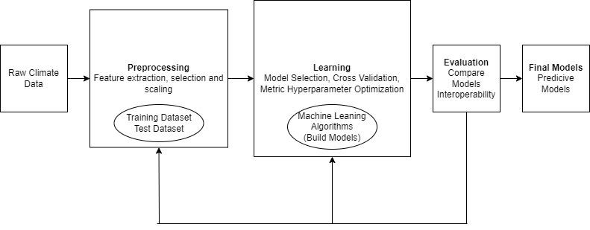
Design Framework
Fig.2. Data Workflow of Weather Forecasting System
Dept of CSE., SOE-Dayananda Sagar University
12 of 39
*

Slide 13
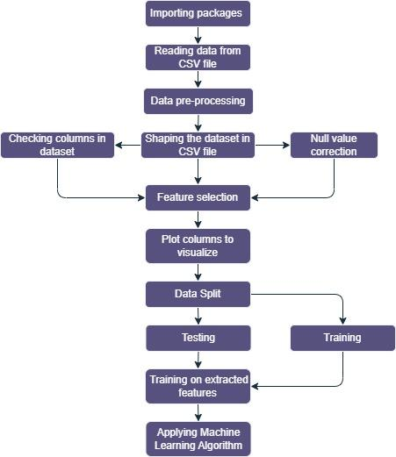
Design
Fig.3. Design architecture of EDA
Dept of CSE., SOE-Dayananda Sagar University
13 of 39

Slide 14
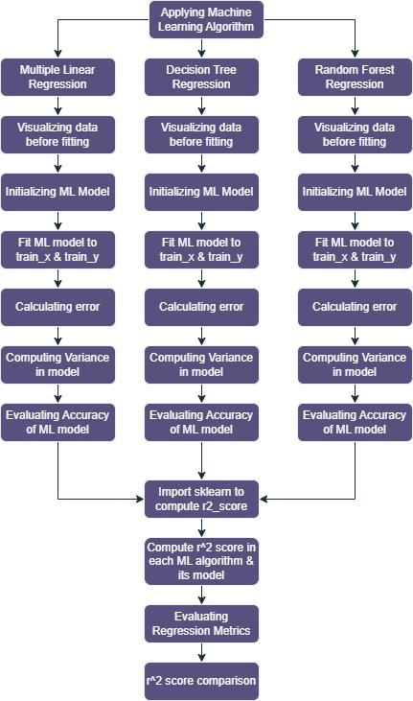
Fig.4.Work flow of MLmodel
Dept of CSE., SOE-Dayananda Sagar University
14 of 39

Slide 15
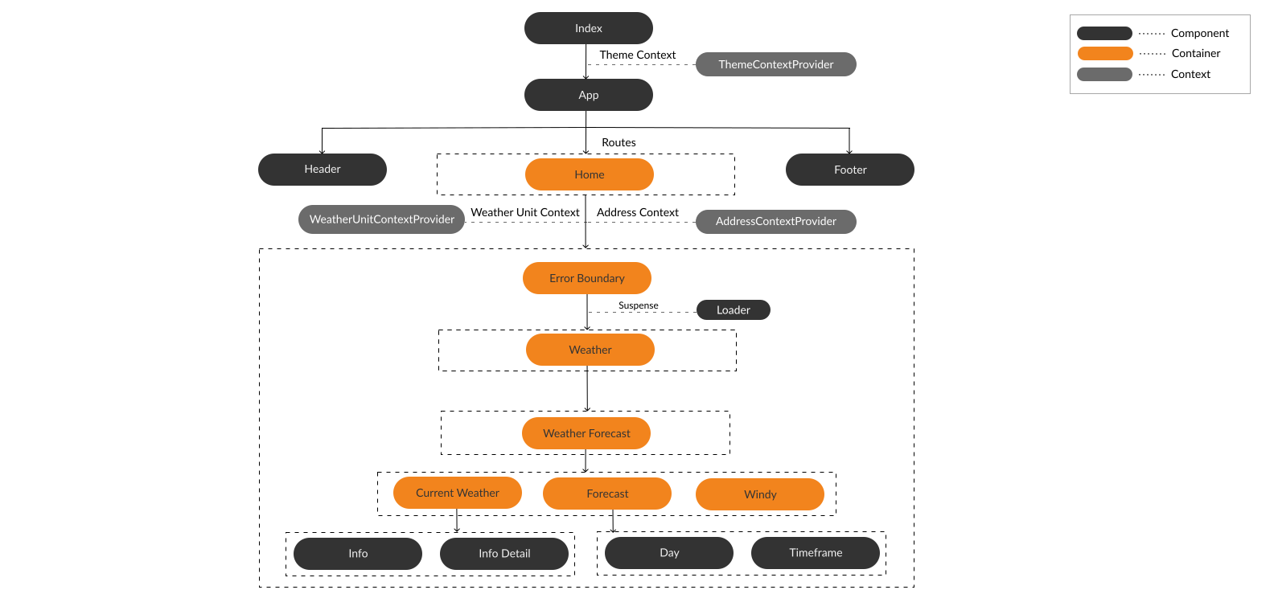
Weather App Architecture
Fig.5. Architecture of Weather Forecasting App
Dept of CSE., SOE-Dayananda Sagar University
15 of 39

Slide 16
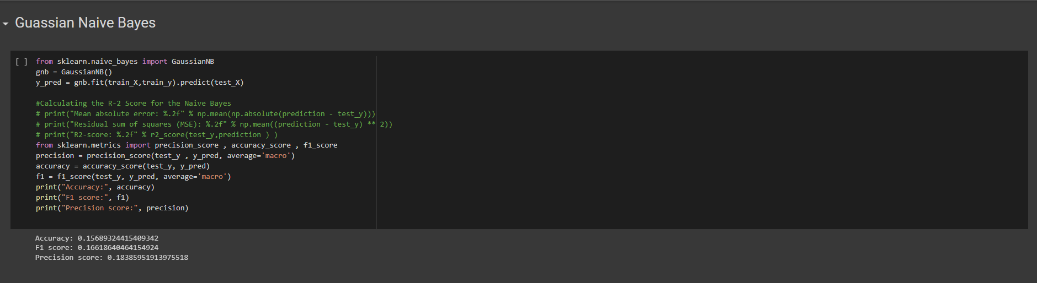
Experimentation Results on Different ML Models
Fig.6. Implementation of Gaussian Naive Bayes Classifier
Dept of CSE., SOE-Dayananda Sagar University
16 of 39

Slide 17

Fig.7. Implementation of Complement Naive Bayes Classifier
Dept of CSE., SOE-Dayananda Sagar University
17 of 39

Slide 18

Fig.8. Implementation of Categorical Naive Bayes Classifier
Dept of CSE., SOE-Dayananda Sagar University
18 of 39

Slide 19

Fig.9. Implementation of Bernoulli Naive Bayes Classifier
Dept of CSE., SOE-Dayananda Sagar University
19 of 39

Slide 20
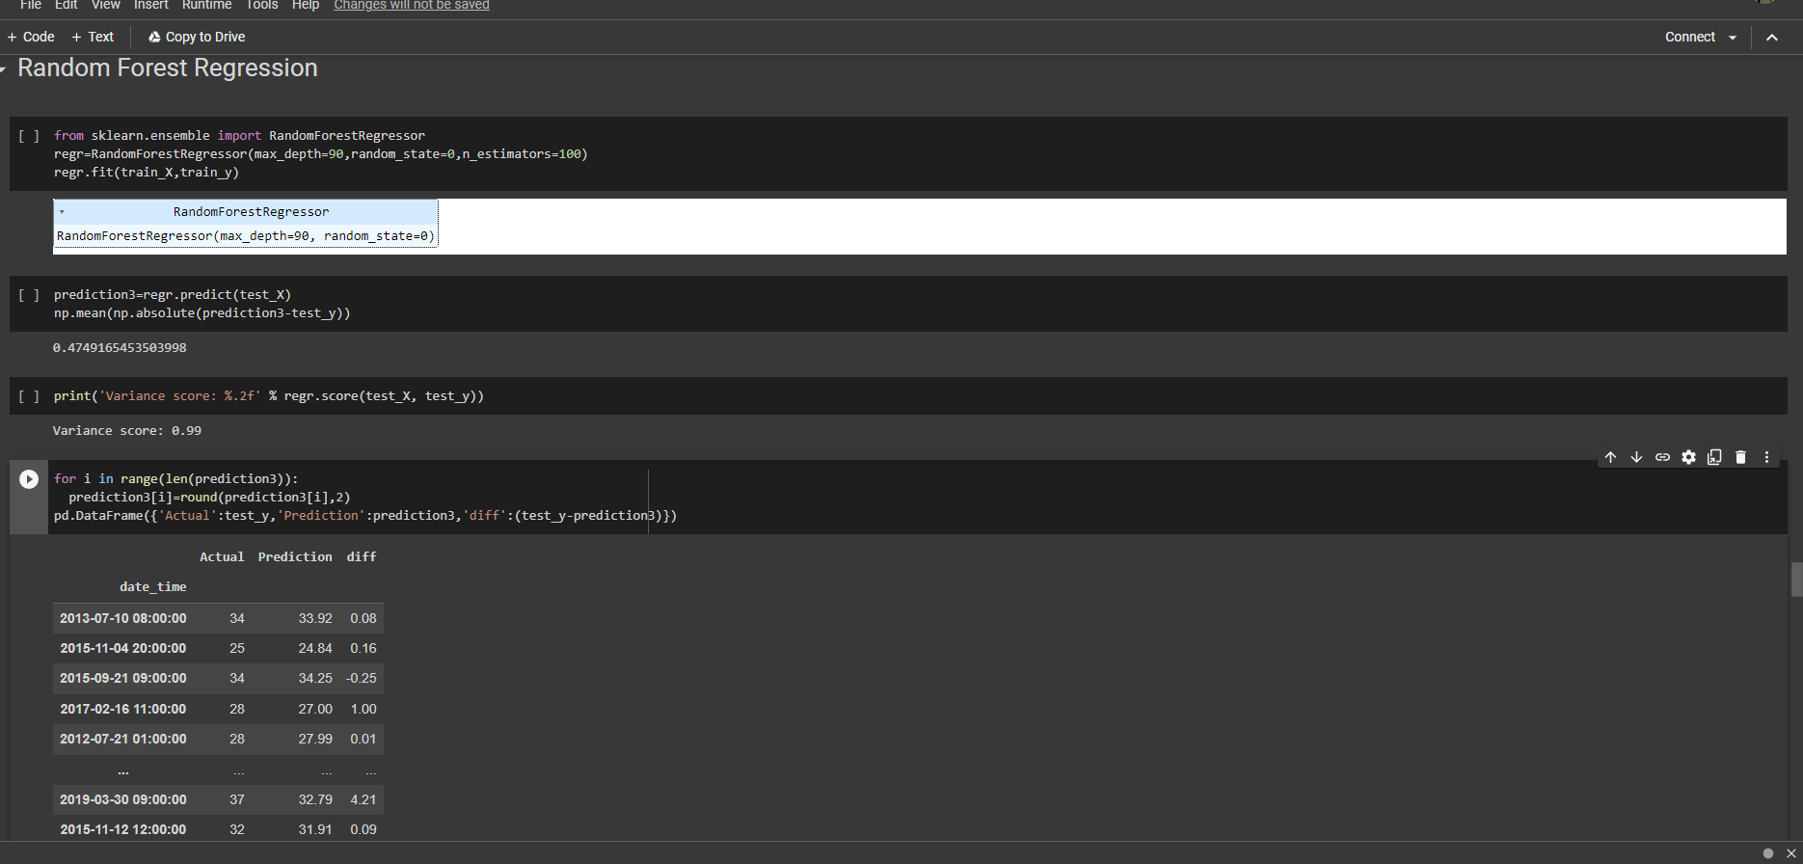
Fig.10. Implementation of Random Forest Regression Classifier
Dept of CSE., SOE-Dayananda Sagar University
20 of 39

Slide 21
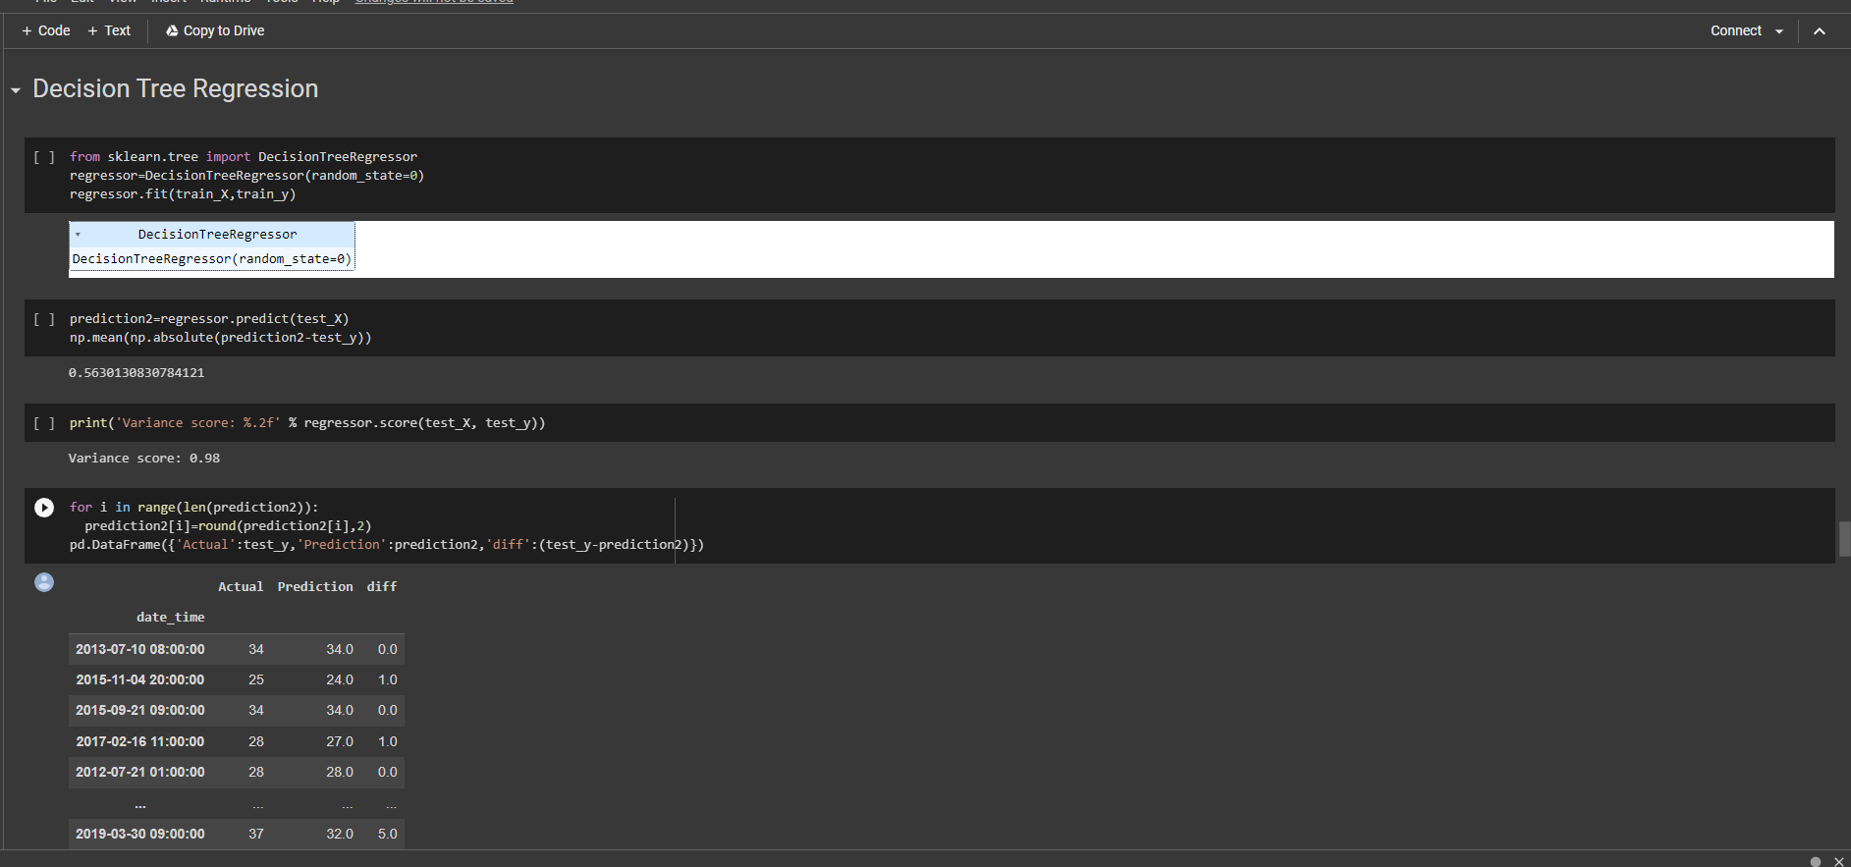
Fig.11. Implementation of Decision Tree Regression Classifier
Dept of CSE., SOE-Dayananda Sagar University
21 of 39

Slide 22
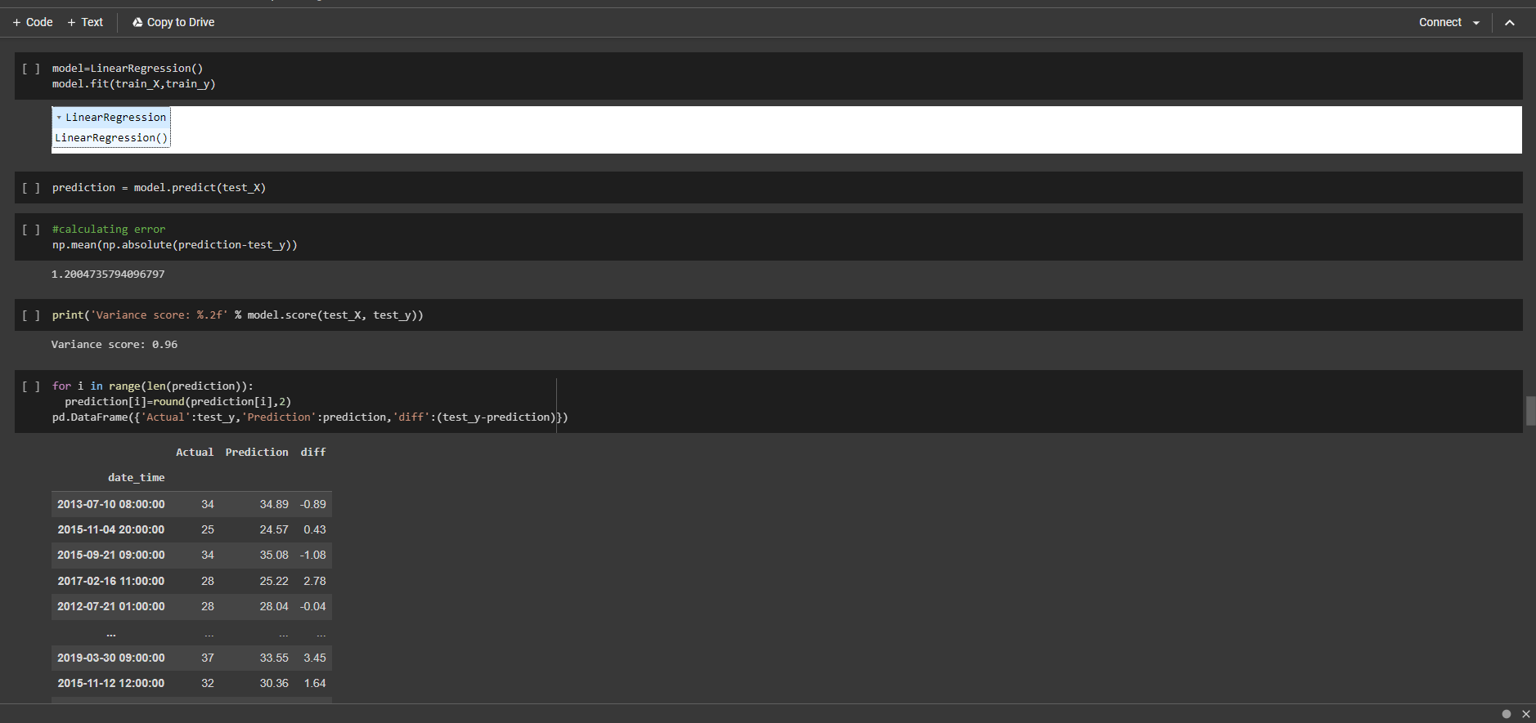
Fig.12. Calculating NP error
Dept of CSE., SOE-Dayananda Sagar University
22 of 39

Slide 23
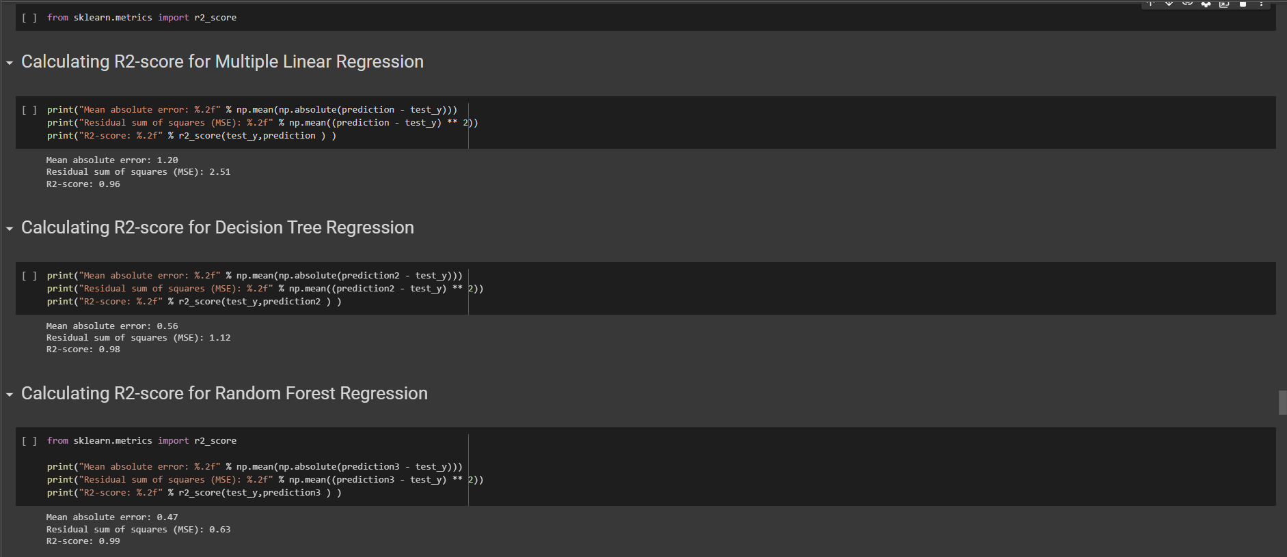
Fig.13. Calculating R2 Score for all 3 Classifiers
Dept of CSE., SOE-Dayananda Sagar University
23 of 39

Slide 24
Acid Rain
Acid rain is a major regional-scale environmental problem all over the world.
Acid deposition is formed from SO2 and NOx emitted to the atmosphere, largely because of fossil-fuel combustion, especially transportation sources.
According to studies atmospheric pressure had positive effects, while temperature and relative humidity had a negative influence on the concentrations of SO2 and NO2 in the atmosphere
Dept of CSE., SOE-Dayananda Sagar University
24 of 39

Slide 25
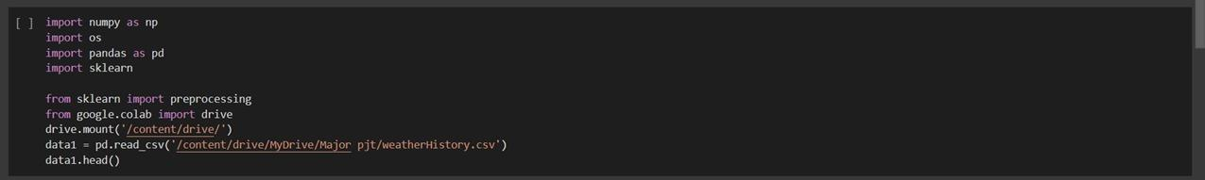
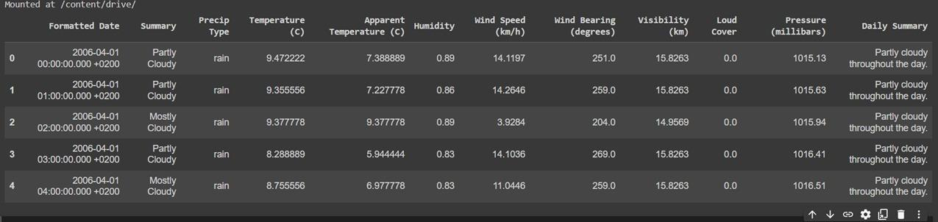
Fig.14. Importing packages for pre-processing
Fig.15. Displaying formatted data
Dept of CSE., SOE-Dayananda Sagar University
25 of 39

Slide 26
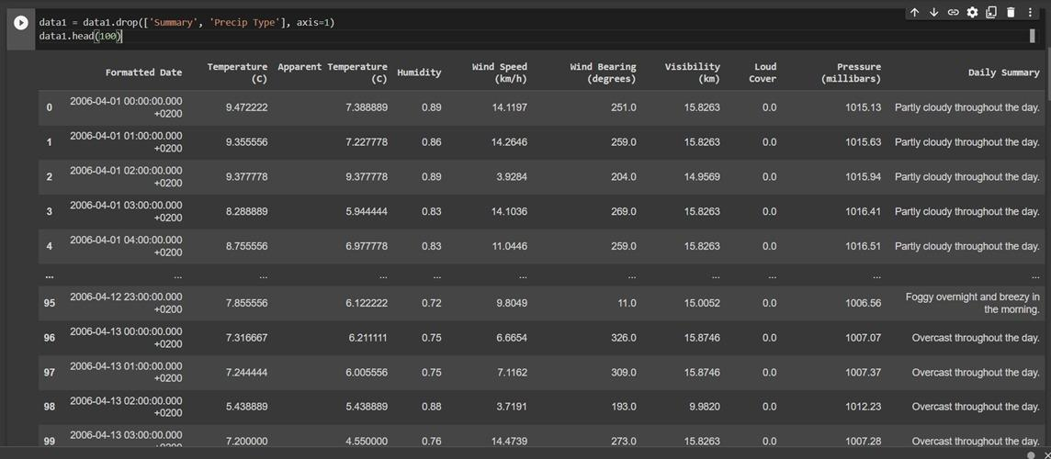
Fig.16. Displaying top 100 records
Dept of CSE., SOE-Dayananda Sagar University
26 of 39

Slide 27
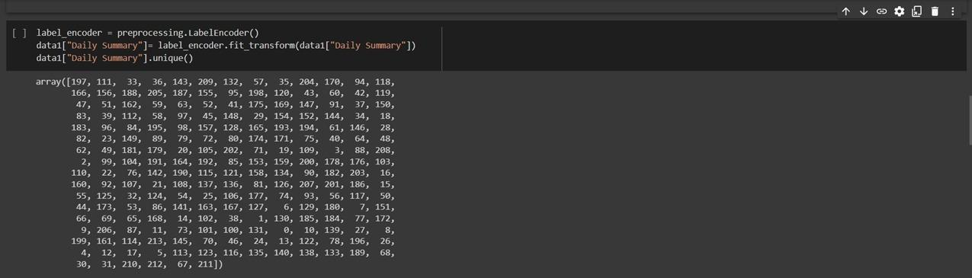
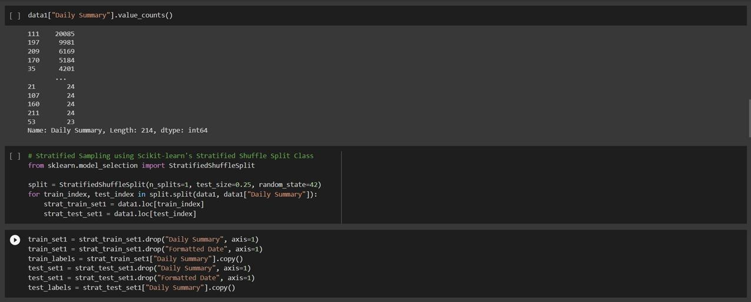
Fig.17. Displaying label encoders in array[]
Fig.18. Stratified Sampling
Dept of CSE., SOE-Dayananda Sagar University
27 of 39

Slide 28
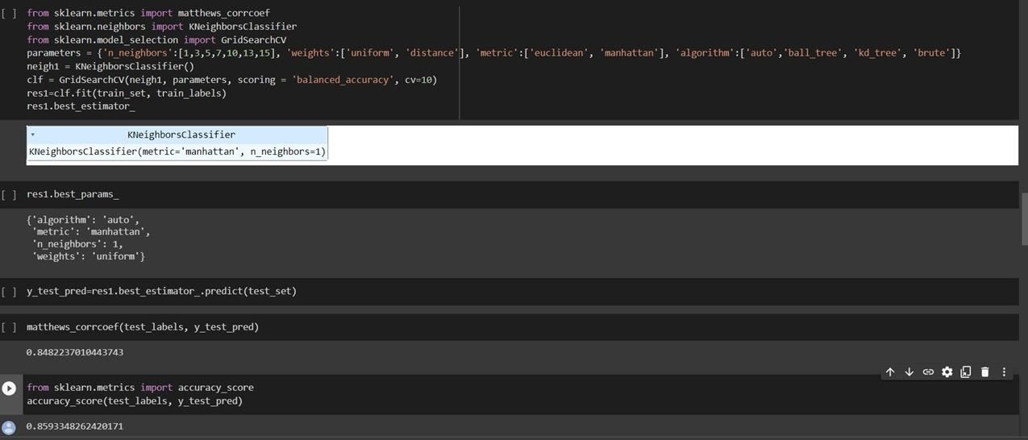
Fig.19. Splitting dataset into Testing & Training
Dept of CSE., SOE-Dayananda Sagar University
28 of 39

Slide 29
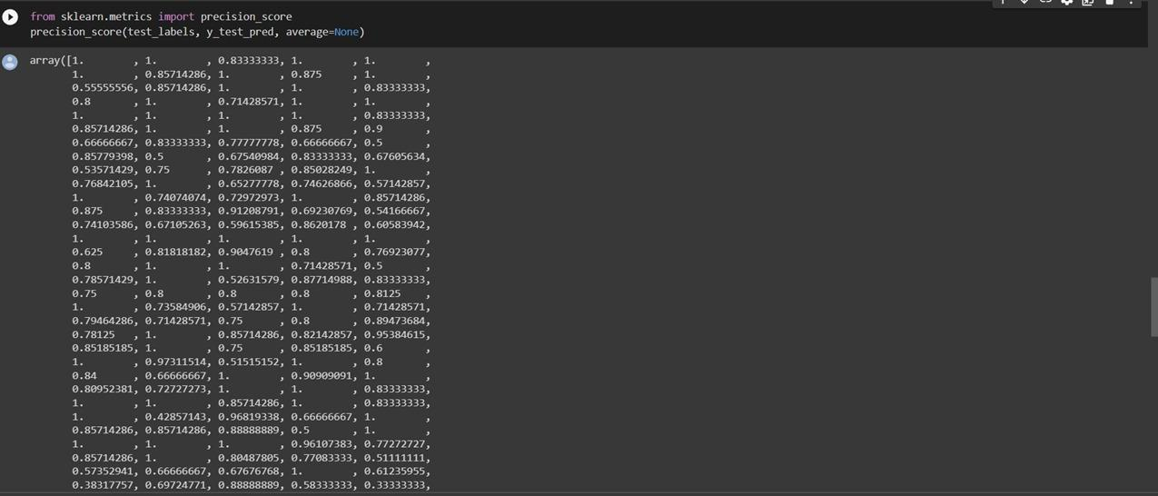
Fig.20. Calculating precision score for the testing dataset
Dept of CSE., SOE-Dayananda Sagar University
29 of 39

Slide 30
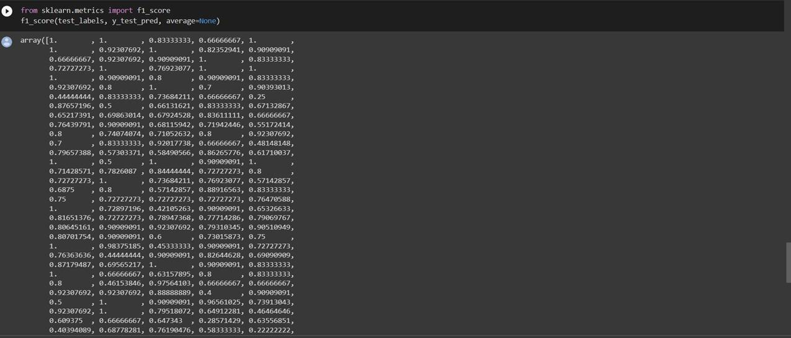
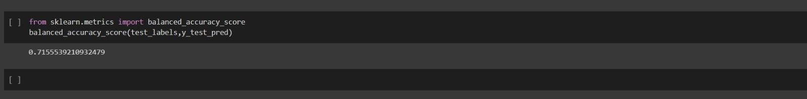
Fig.21. Calculating F1 score for the given dataset
Fig.22. Checking accuracy of the used model
Dept of CSE., SOE-Dayananda Sagar University
30 of 39

Slide 31
Deliverables
Finally this brings us to a point where we can deliver the weather prediction app onto our local machines
This solves the issue of accessibility and feasibility
To better show the deliverables, we have created the weather prediction system.
This designed system is much more pleasing to the eye and higher interactive than your average weather app.
Dept of CSE., SOE-Dayananda Sagar University
31 of 39
*

Slide 32
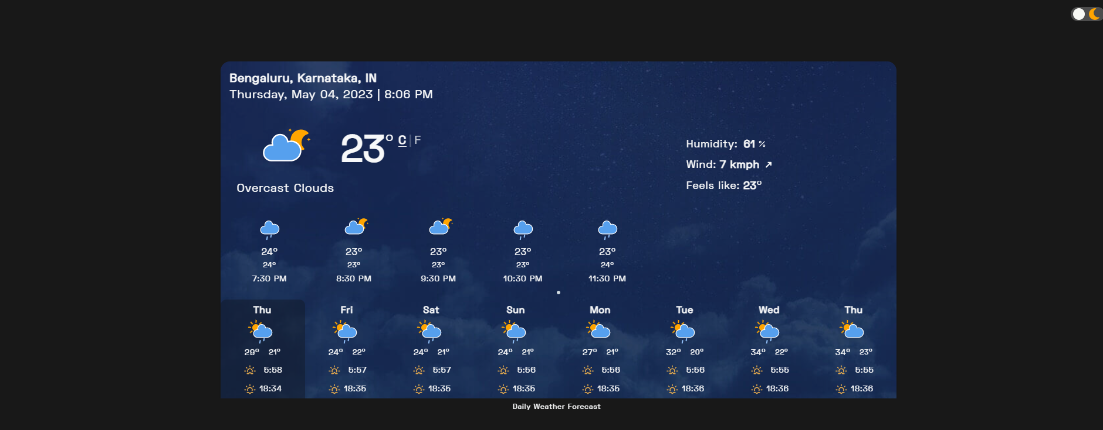
Weather Prediction System
Fig.23. Landing page screenshot for the Weather App
Dept of CSE., SOE-Dayananda Sagar University
32 of 39

Slide 33

Fig.24. Wind data displayed with Interactive Map
Dept of CSE., SOE-Dayananda Sagar University
33 of 39

Slide 34

Fig.25. Displaying different parameters in the map
Dept of CSE., SOE-Dayananda Sagar University
34 of 39

Slide 35

Fig.26. Displaying Radar & Lightning predictions in different zones in the map
Dept of CSE., SOE-Dayananda Sagar University
35 of 39

Slide 36

Fig.27. Wind data for a larger area with Wind direction
Dept of CSE., SOE-Dayananda Sagar University
36 of 39

Slide 37
References
[1]. K Geetha Rani, Dr D C Joy Winnie, S Sufiyah Begum, S Nirosha ‘Designing a model for weather forecasting using machine learning’ , IEEE Journal, August 2020.
[2]. Bogdan Bochenek, Zbigniew Ustrnul, ‘Machine learning in weather prediction and climate analyses – applications and perspectives’, MDPI Atmosphere Journal, January 2022.
[3]. A H M Jakaria, Md Mosharaf Hossain, Mohammad Ashiqur Rahman, ‘Smart weather forecasting using machine learning: a case study in Tennessee’, Researchgate Journal, August 2020.
[4]. Nitin Singh, Saurabh Chaturvedi, Shamim Akhter, ‘Weather forecasting using machine learning’, IEEE Journal, December 2019.
[5]. Siddharth Singh, Mayank Kaushik, Ambuj Gupta, Anil Kumar Malviya, ‘Weather forecasting using Machine learning techniques’, Galgotias University, February 2037.
Dept of CSE., SOE-Dayananda Sagar University
37 of 39

Slide 38
[6]. Dires Negash Fente, Dheeraj Kumar Singh, ‘Weather Forecasting Using Artificial Neural Network’, IEEE, International conference 2018.
[7].Pradeep Hewage, Marcello Trovati, Ella Pereira and Ardhendu Behera ‘Deep learning-based effective fine-grained weather forecasting model’, Elsevier Journal 2020
[8]. Kumar Abhishek, M.P.Singh, Saswata Ghosh, Abhishek Anand, ‘Weather forecasting model using Artificial Neural Network’ , Elsevier Journal ,2012.
[9]. Imran Maqsood, Muhammad Riaz Khan, Ajith Abraham , ‘An ensemble of neural networks for weather forecasting’ , Springer , Journal , May 2020.
[10].Kartika Purwandari, Join W. C.Sigalingging , Tjeng Wawan Cenggoro , Bens Pardamean, ‘Multi-class Weather Forecasting from Twitter Using Machine Learning Approaches’ , Elsevier , Conference , 4 sep 2020.
[11]. Raymond Lee and James Liu, ‘ iJADE WeatherMAN: A Weather Forecasting System Using Intelligent Multi agent-Based Fuzzy Neural Network’ , IEEE , Journal , August 2020.
Dept of CSE., SOE-Dayananda Sagar University
38 of 39

Slide 39


